Slide 1
Data-driven crystal elastic constants prediction and selection
By Xusen Qin and Linhan Peng

Slide 2
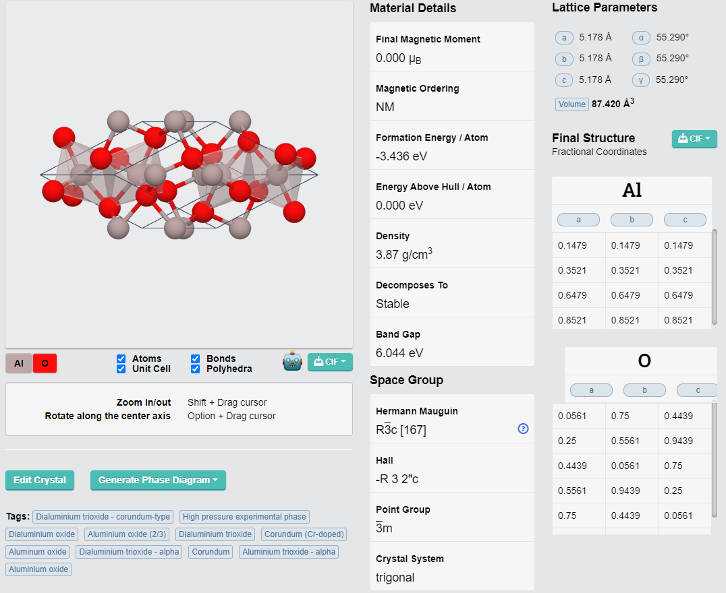
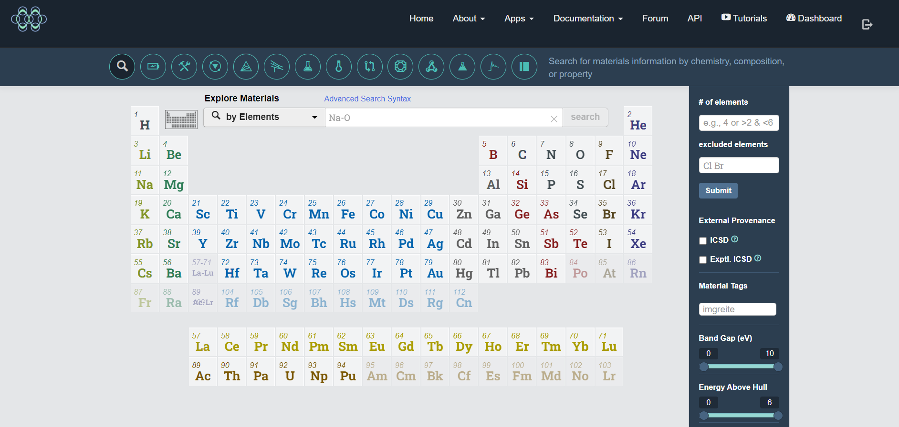
Data Collection
Energy/Atom
Volume/Atom
Pretty formula
Symbol
Hall
Print group
Crystal system
Formation energy/Atom
Density
Oxide type
Atom number
Introduction&
outline
https://materialsproject.org/

Slide 3
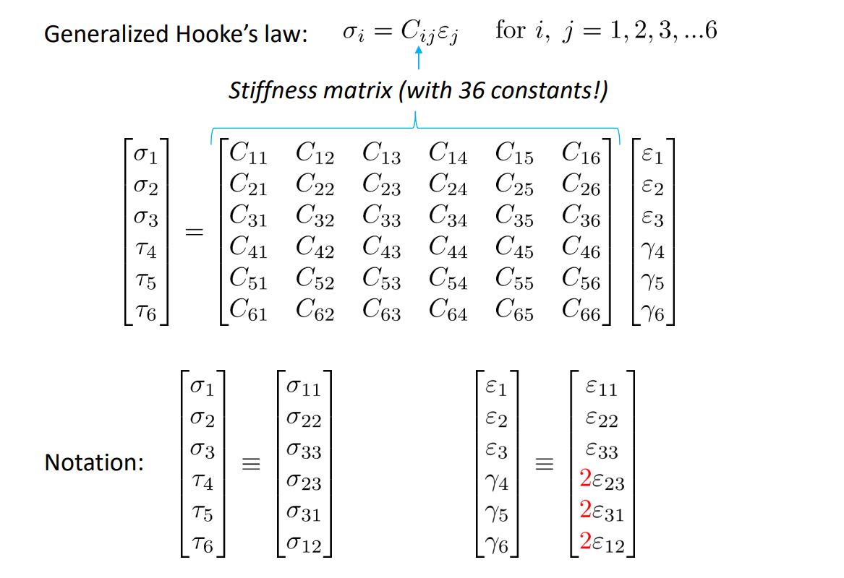
Elastic tensor
Introduction&
outline

Slide 4
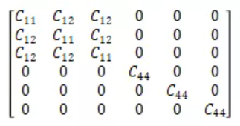
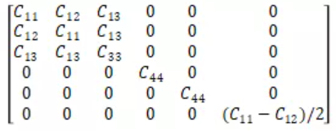
Elastic tensor
Introduction&
outline
Cubic system
(C₁₁,C₁₂,C₄₄)
Hexagonal system
(C₁₁,C₁₂,C₁₃,C₃₃,C₄₄)

Slide 5
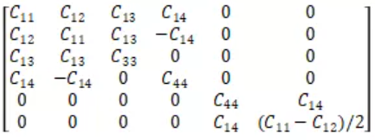
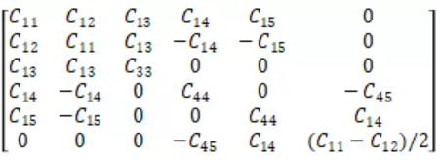
Elastic tensor
Introduction&
outline
Trigonal system
(C₁₁ , C₁₂ , C₁₃ , C₁₄ , C₃₃ , C₄₄)
(C₁₁ , C₁₂ , C₁₃ , C₁₄ , C₁₅ , C₃₃ , C₄₄ , C₄₅)

Slide 6
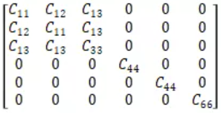
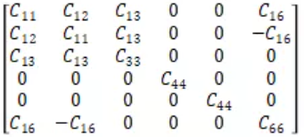
Elastic tensor
Introduction&
outline
Tetragonal system
(C₁₁ , C₁₂ , C₁₃ , C₃₃ , C₄₄ , C₆₆)
(C₁₁ , C₁₂ , C₁₃ , C₁₆ , C₃₃ , C₄₄ , C₆₆)

Slide 7
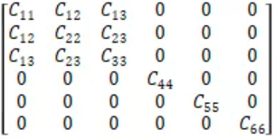
Elastic tensor
Introduction&
outline
Energy/Atom
Volume/Atom
Pretty formula
Symbol
Hall
Print group
Crystal system
Formation energy/Atom
Density
Oxide type
Atom number
Orthogonal crystal system
(C₁₁ , C₁₂ , C₁₃ , C₂₂ , C₂₃ , C₃₃ , C₄₄ , C₅₅ , C₆₆)
The higher the symmetry of the crystal system, the smaller the number of independent tensor elements.
Monoclinic system

Slide 8
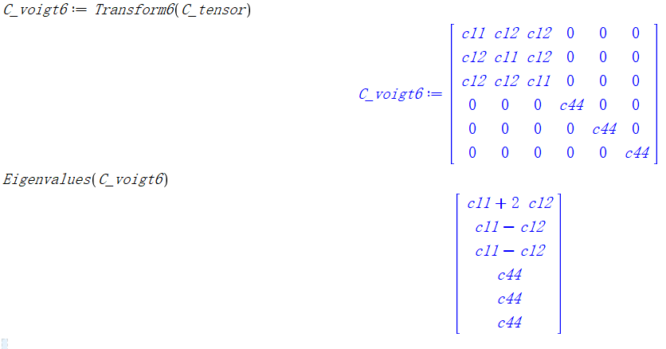
Eigenvalues
Introduction&
outline
Elastic Tensor (6 dimensional tensor)
Eigenvalues
E₀ =
E₁ =
E₂ =

Slide 9
Bulk modulus & Shear modulus
Introduction&
outline
Bulk modulus B = (1/3)E₀
= (C₁₁ + 2C₁₂)
Shear modulus γ = E₂ = C₄₄

Slide 10
Conventional methods
Faculties
Introduction&
outline
Fist principles
Density functional theory(DFT)
Slow
Complicated program
Models is hard to be reused

Slide 11
Introduction&
outline
Input_2
Input_1
Input_3
C₁₁, C₁₂, C₄₄, E₀, E₁, E₂
Machine learning

Slide 12
Machine Learning
Faculties
Introduction&
outline
Efficiency
More concise program
Models can be easily reused
Training a machine model to fit the elastic tensor(C₁₁, C₁₂, C₄₄, E₁, E₂, E₃)
Improving the accuracy of the models, change the RF to DNN and find a new type of encoder.

Slide 13
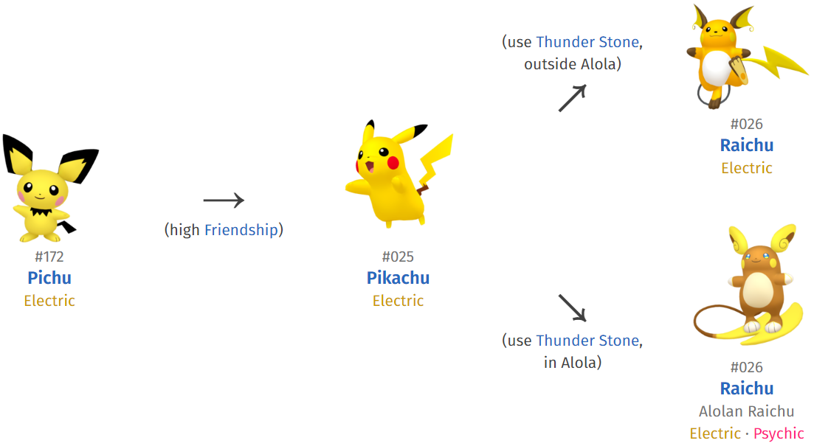
Evolutionary Algorithm(EA)
Faculties
Introduction&
outline
3.Use Evolutionary algorithm to find the crystal structure when Bulk modulus is max.

Slide 14
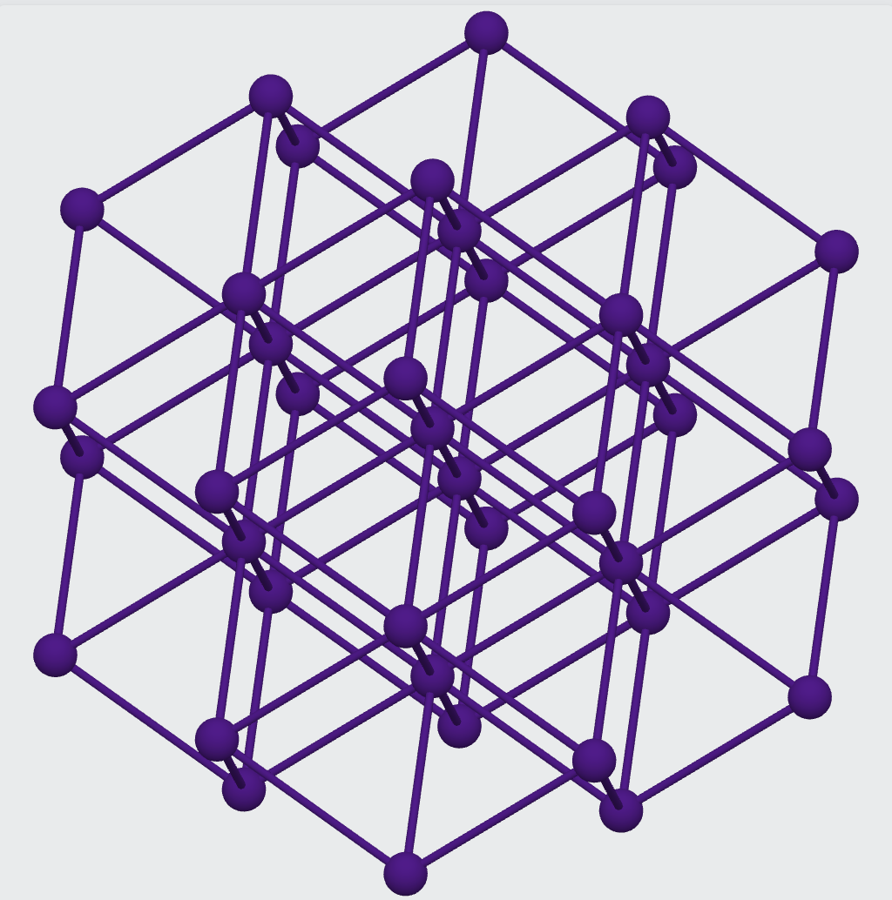
1. Data description
DATA
Cs1

Slide 15
1. Data description
DATA
Input data
Pretty formula | Cs1 | Crystal system | Cubic
Energy/Atom (eV/Atom) | -0.86 | Point group | m-3m
Volume/Atom (Å³/Atom) | 114.05 | Density (g/cm³) | 1.93
Symbol | Im-3m | Oxide type | None
Hall | -I 4 2 3 | Number of atoms | 1
Formation energy/Atom (eV/Atom) | 0.039 | 11 dimensional inputs

Slide 16
1. Data description
DATA
Output data
2.0 | 2.0 | 2.0 | 0.0 | 0.0 | 0.0
2.0 | 2.0 | 2.0 | 0.0 | 0.0 | 0.0
2.0 | 2.0 | 2.0 | 0.0 | 0.0 | 0.0
0.0 | 0.0 | 0.0 | 1.0 | 0.0 | 0.0
0.0 | 0.0 | 0.0 | 0.0 | 1.0 | 0.0
0.0 | 0.0 | 0.0 | 0.0 | 0.0 | 1.0
Eigenvalue 1 | Eigenvalue 2 | Eigenvalue 3
6.0 | 1.0 | 1.0
2.0 | 2.0 | 2.0 | 0.0 | 0.0 | 0.0
2.0 | 2.0 | 2.0 | 0.0 | 0.0 | 0.0
2.0 | 2.0 | 2.0 | 0.0 | 0.0 | 0.0
0.0 | 0.0 | 0.0 | 1.0 | 0.0 | 0.0
0.0 | 0.0 | 0.0 | 0.0 | 1.0 | 0.0
0.0 | 0.0 | 0.0 | 0.0 | 0.0 | 1.0
Bulk Modulus (Voigt-Reuss-Hill) | Shear Modulus (Voig- Reuss-Hill)
2.0 | 2.0
Stiffness Matrix C_{ij} (GPa)

Slide 17
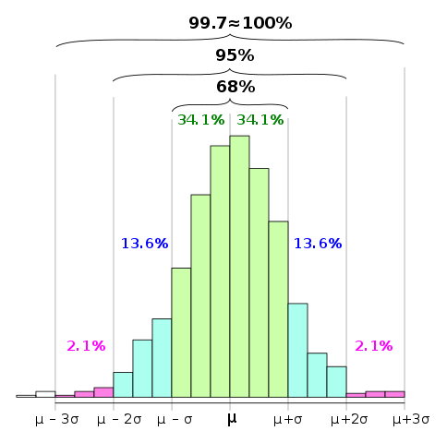
3. Data filtering
DATA
C₁₁ + 2C₁₂ > 0
C₁₁ - C₁₂ > 0
for cubic crystal system
Stability
C₁₁ > 0
C₁₂ > 0
C₄₄ > 0
2. 3σ-rule
3. Compound less than 5 elements

Slide 18
3. Data treatment
DATA
Input data
Pretty formula | Cs1 | Crystal system | Cubic
Energy/Atom (eV/Atom) | -0.86 | Point group | m-3m
Volume/Atom (Å³/Atom) | 114.05 | Density (g/cm³) | 1.93
Symbol | Im-3m | Oxide type | None
Hall | -I 4 2 3 | Number of atoms | 1
Formation energy/Atom (eV/Atom) | 0.039 | 11 dimensional inputs

Slide 19
3. Data treatment
DATA
How to transform the separate string to digit?
Label encoder
One-Hot encoder
[Dog, Cat, Dog, Mouse, Cat]
[Dog, Cat, Dog, Mouse, Cat]
[1, 2, 1, 3, 2]
[[0, 0, 1], [0, 1, 0], [0, 0, 1], [1, 0, 0], [0, 1, 0]]

Slide 20
3. Data treatment
DATA
Input data
Pretty formula | 702 | Crystal system | 0
Energy/Atom (eV/Atom) | -0.86 | Point group | 27
Volume/Atom (Å³/Atom) | 114.05 | Density (g/cm³) | 1.93
Symbol | 43 | Oxide type | 0
Hall | 16 | Number of atoms | 1
Formation energy/Atom (eV/Atom) | 0.039 | 11 dimensional inputs

Slide 21
1. Model selection
MODEL
Energy
Pretty formula
Volume
Cluster
Formation energy
Density
Crystal system

Slide 22

2. Random Forest
MODEL

Slide 23
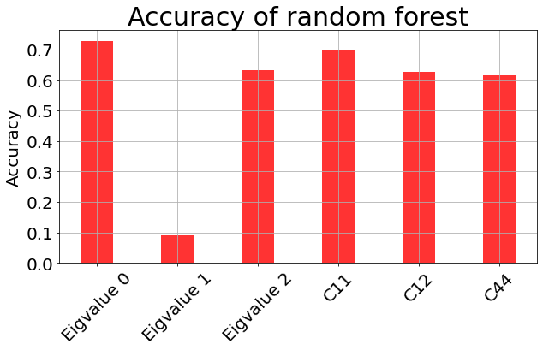
2.1. Results
MODEL
Not enough?

Slide 24
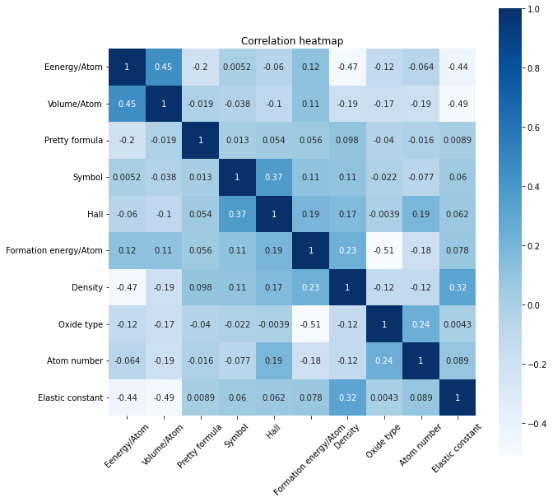
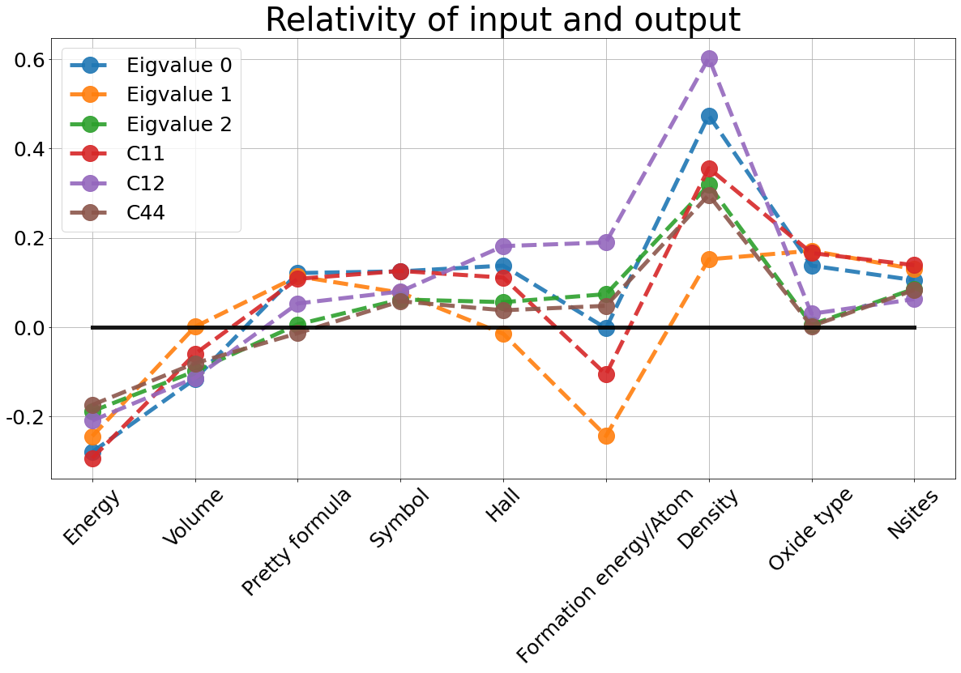
2.2 Discussion
MODEL
The data do not corelate with each other, which means the dataset cannot be clustered.
The elastic constants are more related to the Density

Slide 25
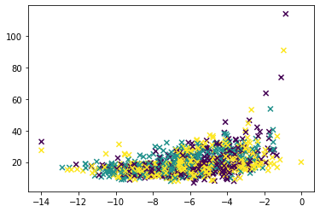
2.2. Discussion
MODEL
The data do not corelate with each other, which means the dataset cannot be clustered.
Random forest is based on the growth of the trees.
Random forest doesn’t preform good enough.

Slide 26
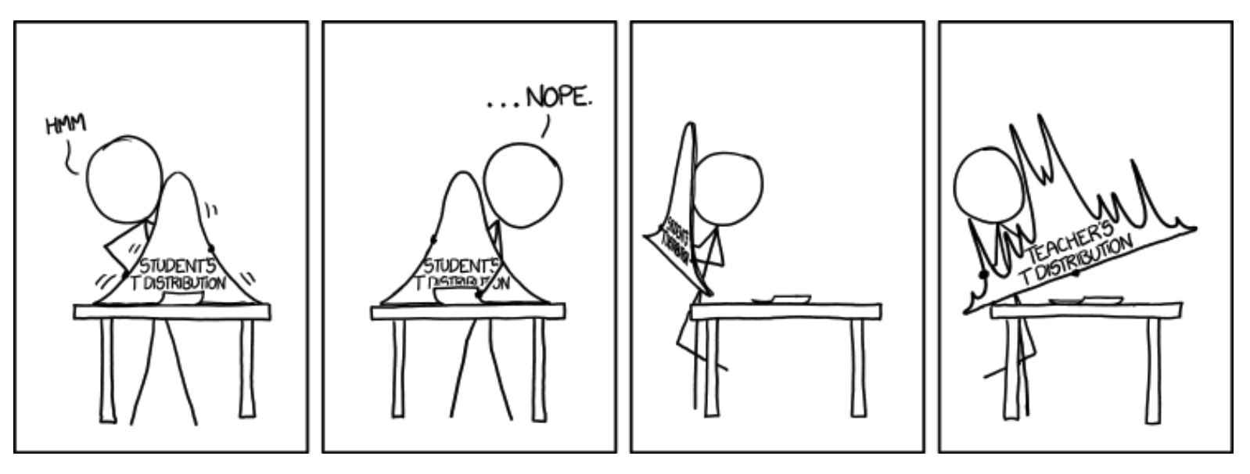
3. Improvement
MODEL

Slide 27
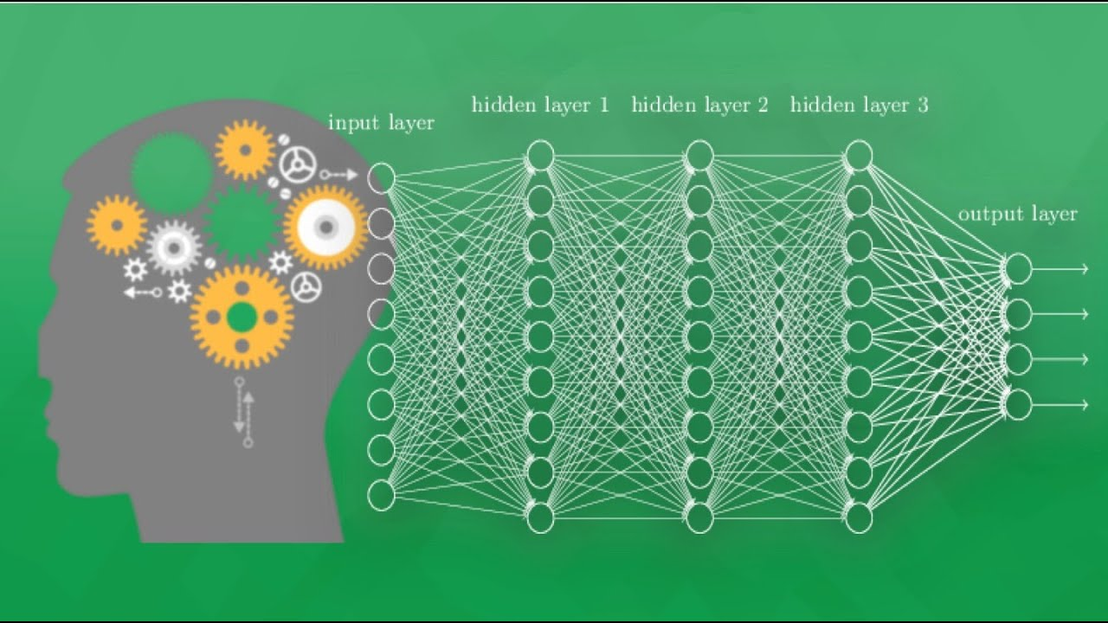
4. Deep Learning
MODEL
Input
Hidden layer 1 (30 Neurals)
Hidden layer 2 (50 Neurals)
Hidden layer 3 (50 Neurals)
Hidden layer 4 (20 Neurals)
Output

Slide 28
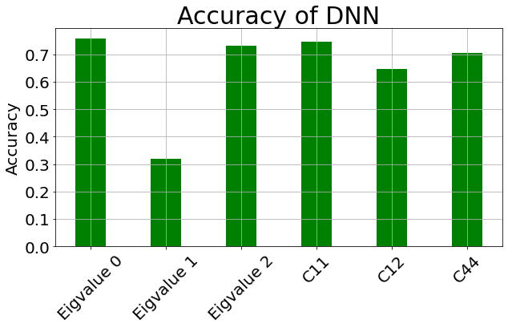
4.2. Results
MODEL

Slide 29
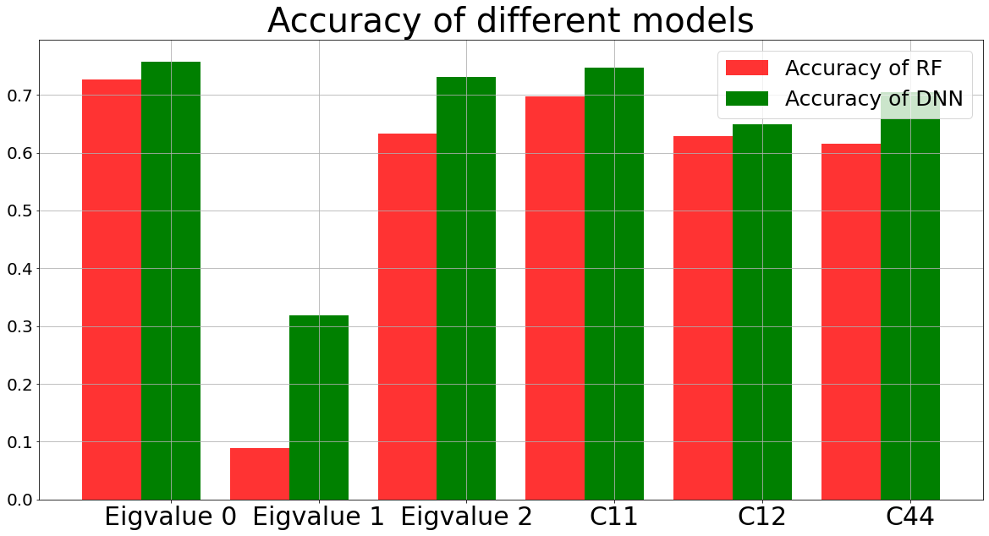
4.2. Results
MODEL

Slide 30
5. Encoder improvement
MODEL
Label encoder
[Dog, Cat, Dog, Mouse, Cat]
Dog+Cat=Mouse???
[1, 2, 1, 3, 2]

Slide 31
5.1 Element Encoder
MODEL
Cs₂NaErF₆
Na
1
6
2
Cs
Er
F
1
55
2/6
11
1/6
68
1/6
9
6/6
return [55, 0.33, 11, 0.17, 68, 0.17, 9, 1]

Slide 32
5.2 How to input mix-type data?
5.2 How to input mix-type data?
MODEL
MODEL
The first data of the input is encoded and become an 8-dimensional tensor.
The other data are in a 10-dimensional tensor
Neural Network can only input data with same dimension
Num
Num
Num
Outputs
List
Num
Num
Outputs

Slide 33
5.3 Concentrate input 1 (tensor) with input 2 (tensor)
MODEL
np. concatenate（input_1, input_2, axis=1)
Pretty formular
Other input data
Pretty formular
Pretty formular
Other input data
Other input data
Pretty formular + Other input data
Pretty formular + Other input data
Pretty formular + Other input data
concentrate
Add the the dimension of encoded data with other data.
The final dimensions of input data is 8+10=18

Slide 34
DNN
Fully connected layers
Output
Convolutional layers
Pretty formular
Other data
5.4 Convolutional layer mixed DNN (Conv_DNN)
MODEL

Slide 35
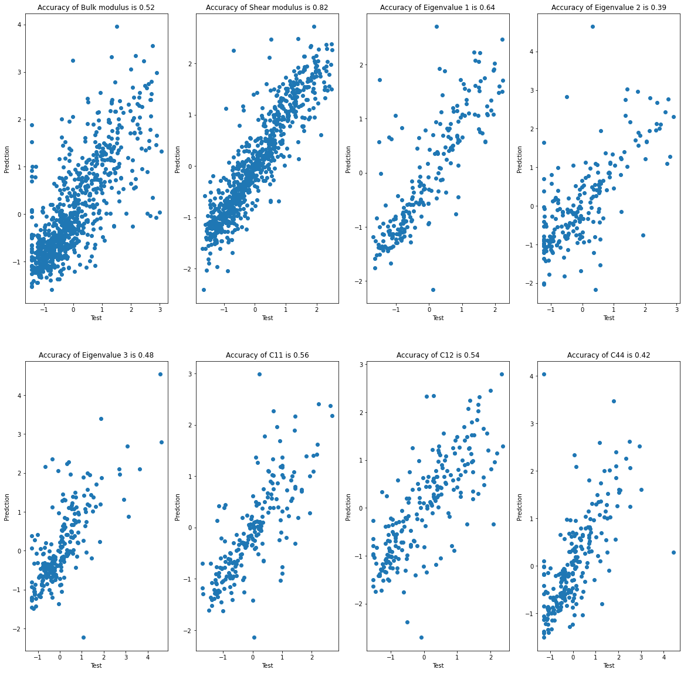
MODEL
Performance of the Label-Encoded model in the accuracy of different output data.
(Bulk modulus, Shear modulus, E₁, E₂, E₃, C₁₁, C₁₂, C₄₄)

Slide 36
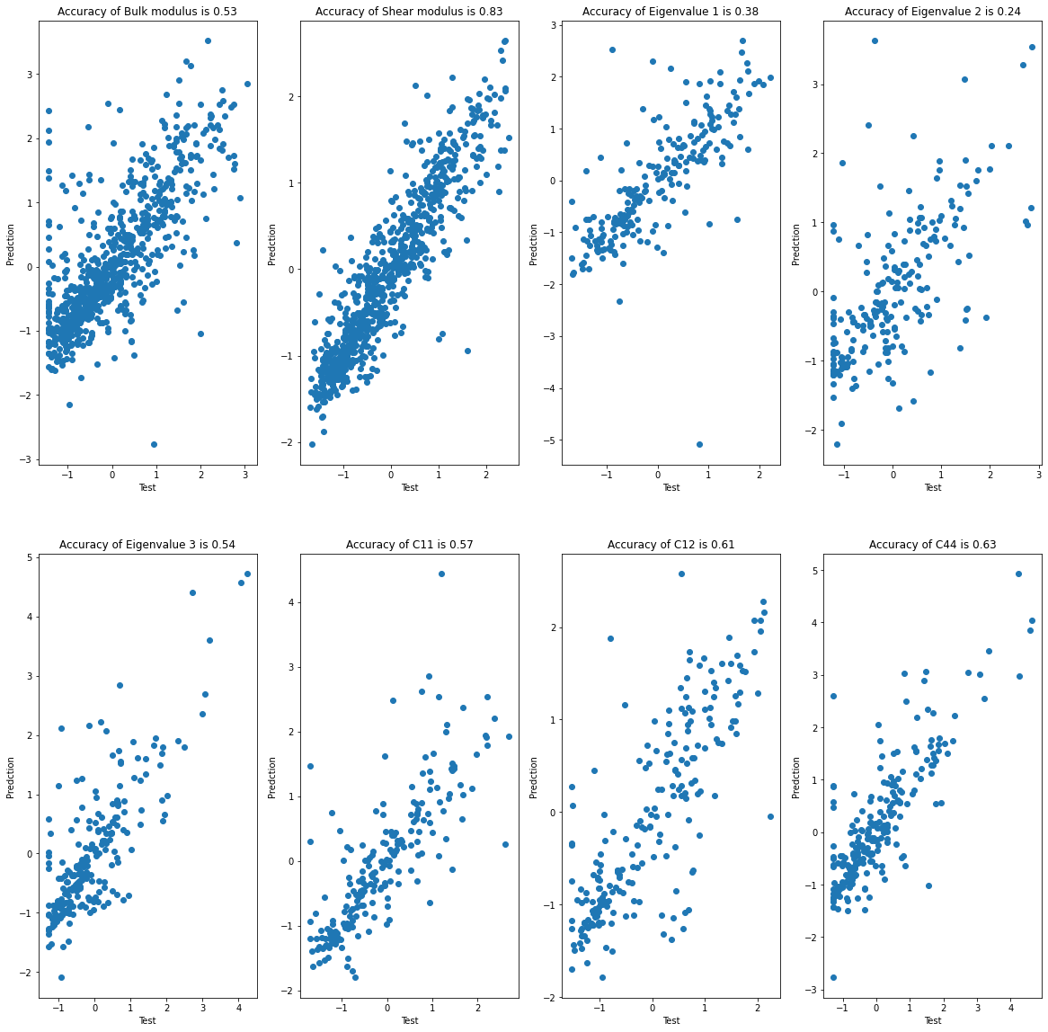
MODEL
Performance of the Full_DNN in the accuracy of different output data.
(Bulk modulus, Shear modulus, E₁, E₂, E₃, C₁₁, C₁₂, C₄₄)

Slide 37
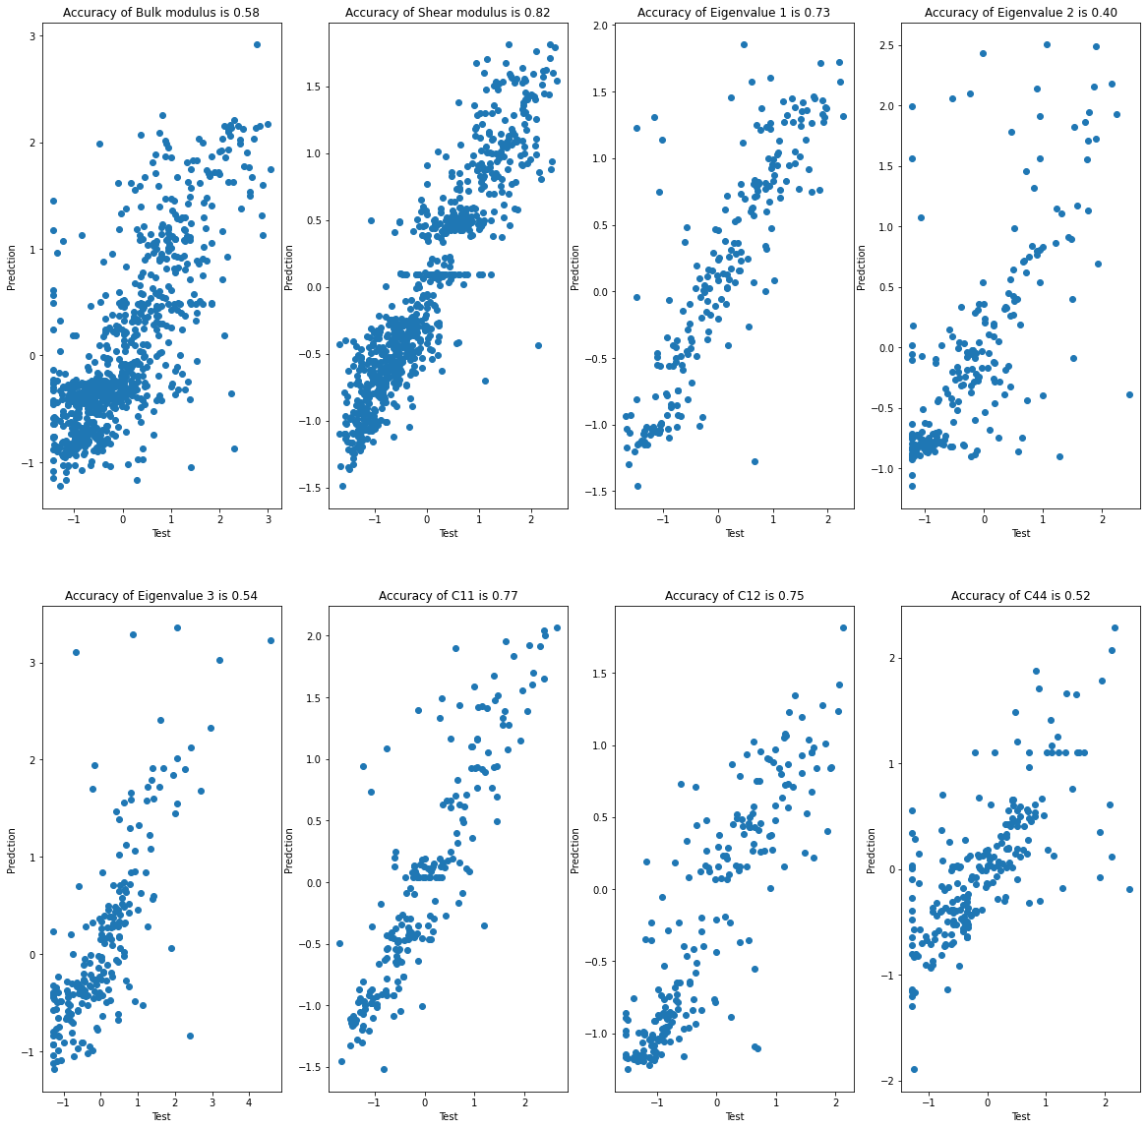
MODEL
Performance of the Conv_DNN in the accuracy of different output data.
(Bulk modulus, Shear modulus, E₁, E₂, E₃, C₁₁, C₁₂, C₄₄)

Slide 38
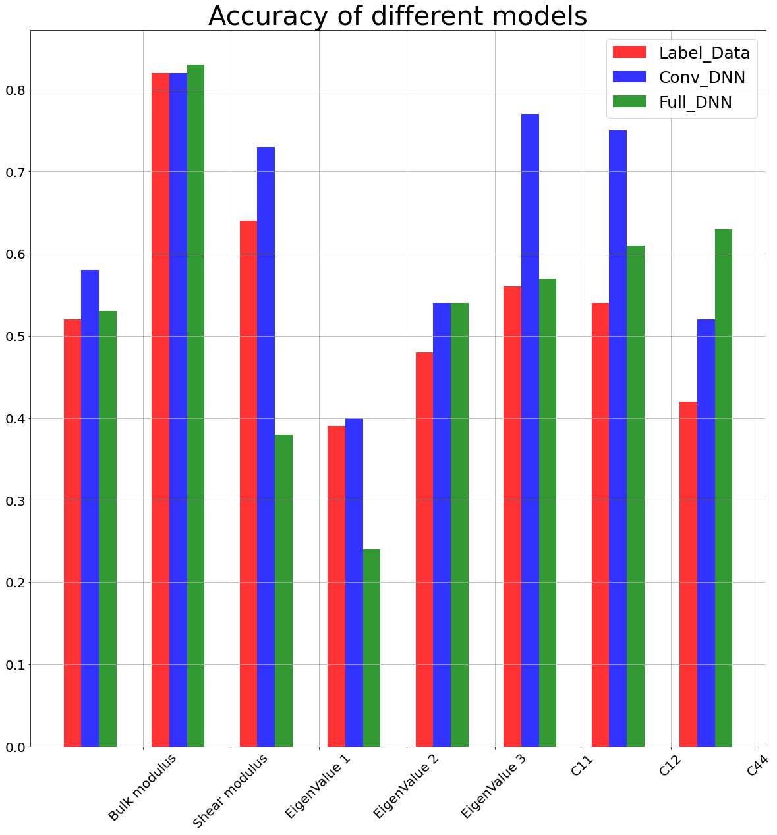
MODEL
Performance of the Deferent model in the accuracy of different output data.
(Bulk modulus, Shear modulus, E₁, E₂, E₃, C₁₁, C₁₂, C₄₄)

Slide 39
1. Evolutionary Algorithm
Optimization
Select
Best individuals
Crossover
Offspring
Generate new population
Genotype Mutate

Slide 40
1.1. Evolutionary strategy
Evolutionary!
Population
Eliminated individuals
Eliminated individuals
Eliminated individuals
Eliminated individuals
Winning individuals

Slide 41
1.1. Evolutionary strategy
Evolutionary!
Using Conv_DNN as the selection pressure to select the best individuals.
The maximum number of generations is 200, the population size is 30.
Input the genotype of individuals in a population into the Conv_DNN, get the Bulk modulus and Shear modulus.
Plus the Bulk and Shear modulus. Record this result as Fitness.
Sort the population with the Fitness, select the best of them to generate offspring.

Slide 42
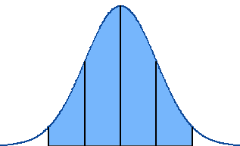
1.2. Gene mutation
Evolutionary!
Individual 1
Pretty formula 1
Energy/Atom 1
Volume/Atom 1
Symbol 1
Hall 1
Point group 1
Crystal system 1
Formation energy/Atom 1
Density 1
Oxide type 1
Number of Atoms 1

Slide 43
1.3 Crossover
Evolutionary!
Individual 1
Pretty formula 1
Energy/Atom 1
Volume/Atom 1
Symbol 1
Hall 1
Point group 1
Crystal system 1
Formation energy/Atom 1
Density 1
Oxide type 1
Number of Atoms 1
Individual 1
Pretty formula 1
Energy/Atom 1
Volume/Atom 1
Symbol 1
Hall 1
Point group 1
Crystal system 1
Formation energy/Atom 1
Density 1
Oxide type 1
Number of Atoms 1
Individual 2
Pretty formula 2
Energy/Atom 2
Volume/Atom 2
Symbol 2
Hall 2
Point group 2
Crystal system 2
Formation energy/Atom 2
Density 2
Oxide type 2
Number of Atoms 2
Individual 2
Pretty formula 2
Energy/Atom 2
Volume/Atom 2
Symbol 2
Hall 2
Point group 2
Crystal system 2
Formation energy/Atom 2
Density 2
Oxide type 2
Number of Atoms 2
Offsping 1
Pretty formula 2
Energy/Atom 1
Volume/Atom 1
Symbol 2
Hall 2
Point group 2
Crystal system 2
Formation energy/Atom 1
Density 1
Oxide type 2
Number of Atoms 1
Offspring 2
Pretty formula 1
Energy/Atom 2
Volume/Atom 2
Symbol 1
Hall 1
Point group 1
Crystal system 1
Formation energy/Atom 2
Density 2
Oxide type 1
Number of Atoms 2
Generate

Slide 44
1.3 Crossover
Evolutionary!
Using the winning individuals to generate offsping
Randomly switch the genotypes of the individuals.
Offspring inherit excellent genotype from their parents.
Crossover gives a chance to combine different genotype.

Slide 45
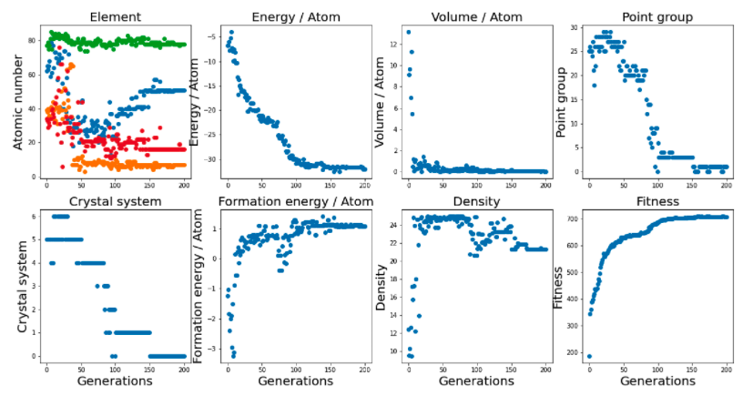
2. Result and discussion
Evolutionary!

Slide 46
2. Result and discussion
Evolutionary!
Pretty formula | Sb_{0.5}N_{0.4}Pt_{0.3}S_{0.5} | Point group | m-3m
Energy/Atom (eV/Atom) | -32.05 | Density (g/cm³) | 1.93
Volume/Atom (Å³/Atom) | 0.0038 | Oxide type | oxide
Symbol | Amm2 | Number of atoms | 3
Hall | R 3 2 | Bulk modulus (Gpa) | 250.90
Formation energy/Atom (eV/Atom) | 1.075 | Shear modulus (Gpa) | 456.3
Crystal system | Cubic

Slide 47
2. Result and discussion
Evolutionary!
Main result
Fitness finally converge on about 700Gpa
The final crystal is a alloy with cubic system
The higher energy per atoms, the larger Fitness
Small volume and high-density crystal tend to have higher fitness

Slide 48
Conclusion
Training two machine learning models with the maximum prediction accuracy is 82%.
Designing a feasible encoding method to describe pretty formula of compounds.
Using Evolutionary algritham to find the optimal solution with highest mechanics property.

Slide 49
Drawbacks
Volume/Atom is lower than real situation, which means the selection pressure (Conv_DNN) still need to be further improved.
The relationship between different genotype should be considered.

Slide 50
THANK YOU FOR YOUR ATTENTION!

Slide 51
THANK YOU FOR YOUR ATTENTION!

Slide 52
THANK YOU FOR YOUR ATTENTION!

Slide 53
5.1 Element Encoder
MODEL
ScInCu₄
In
4
1
Sc
Cu
1
21
1/4
49
1/4
29
29
0.5 * 4/4
0.5 * 4/4
return [21, 0.25, 49, 0.25, 29, 0.5, 29, 0.5]

Slide 54
5.1 Element Encoder
MODEL
Ti₂Pd₁
2
Ti
1
81
81
Pd
46
0.5 *2/2
0.5*1/2
46
0.5 *2/2
0.5*1/2
return [81, 0.5, 81, 0.5, 46, 0.25, 46, 0.25]

Slide 55
5.1 Element Encoder
MODEL
Ti
1
Ti
81
81
1/4
1/4
81
1/4
81
1/4
return [81, 0.25, 81, 0.25, 81, 0.25, 81, 0.25]

Slide 56
1.2. Gene mutation
Evolutionary!
Gaussian mutation
Sampling a new genotype from the gaussian distribution. The mean of the distribution is the old genotype. And the sigma is the standard deviation of the allelic genes in gene-pool
Mutation provide a chance to produce new gene in the population.

